Slide 1
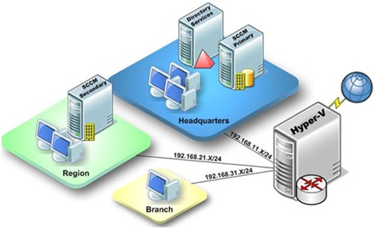
PRESENTATION ON Hyper-V
By ABDUR RAZZAK
ID: 1204149
Batch: ID-NT/ACSL-01M/R28/01
Date: 10/05/2016

Slide 2
What is Hyper-V?
Hyper-V provides the services that you can use to create and manage virtual computing environments and their resources. Virtual computers operate in an isolated operating environment. This lets you to run multiple operating systems at the same time. You can use a virtualized computing environment to improve the efficiency of your computing resources by using more of your hardware resources.

Slide 3
History of Hyper-V
A beta version of Hyper-V was shipped with certain x86-64 editions of Windows Server 2008.
Hyper-V Server 2008 was released on October 1, 2008.
The finalized version was released on June 26, 2008 and was delivered through Windows Update.
Microsoft provides Hyper-V through two channels:
1. Part of Windows: Hyper-V is an optional component of Windows Server 2008 and later. It is also available in x64 SKUs of Pro and Enterprise editions of Windows 8, Windows 8.1 and Windows 10.
2. Hyper-V Server: It is a freeware edition of Windows Server with limited functionality and Hyper-V component.

Slide 4
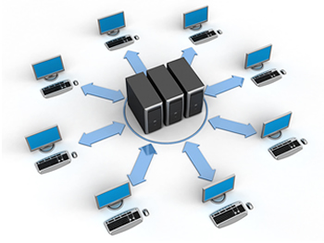
Planning Hyper-V deployment:
Successful deployment requires careful planning. The following issues should be considered when planning the deployment of Hyper-V hosts within your datacenter:
Hardware
Editions
Networking
Storage
Management
Security
Scalability
Availability
Mobility
Disaster recovery

Slide 5
Hardware Requirement
The maximum supported processor and memory capabilities of Windows Server 2012
i | Up to 64 physical processors (sockets) per host
ii | Up to 320 logical processors (cores) per host
iii | Up to 4 TBs of physical memory per host
The maximum supported processor and memory capabilities for virtual machines running on Windows Server 2012 Hyper-V hosts.
i | Up to 64 virtual processors per virtual machine
ii | Up to a total of 2048 virtual processors per host
iii | Up to 1 TB physical memory per virtual machine
iv | Up to 1024 active virtual machines running on the host

Slide 6
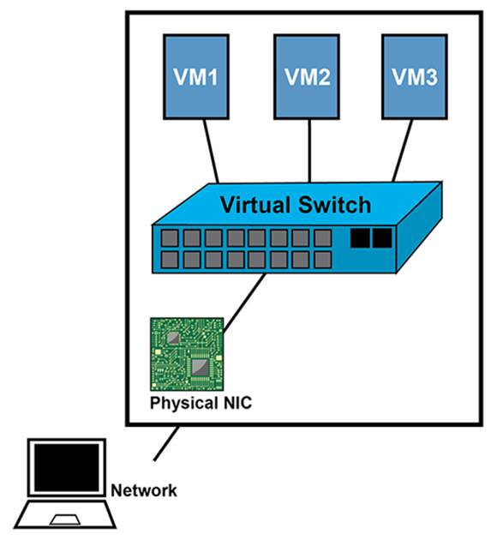
Virtual switch on Hyper-V
A virtual switch is a software program that allows one virtual machine (VM) to communicate with another. Just like its counterpart, the physical Ethernet switch, a virtual switch does more than just forward data packets.

Slide 7
Creating virtual switches
Hyper-V allows us to create three different kinds of virtual switches:
Private: This type of virtual switch allows virtual machines running on the host to communicate only with each other and not with the operating system of the host.
Internal: This type of virtual switch allows virtual machines running on the host to communicate only with each other and with the operating system of the host.
External: This type of virtual switch allows virtual machines running on the host to communicate only with each other and with the operating system of the host, with other systems on the physical network connected to the host through that adapter.

Slide 8
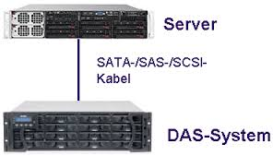
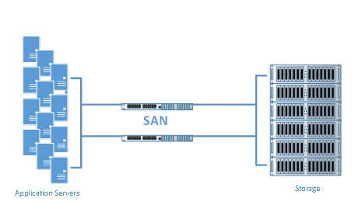
Storage of Hyper-V
The following types of physical storage can be used by Hyper-V hosts for storing virtual machine configuration files and disks:
Direct Attaches Storage (DAS): With DAS solutions, the storage is directly attached to the management operation system.
Storage Area Network (SAN): With SAN solutions, the storage is provided by a set of interconnected devices that are connected to a common communication and data transfer infrastructure, commonly known as the storage fabric.

Slide 9
Planning virtual machine deployment:
The following issues should be considered when crating new virtual machines on a Hyper-V host:
Location of configuration files
Startup memory
Virtual processors
Virtual networking
Virtual hard disks
Guest operating system deployment
Performing snapshots

Slide 10
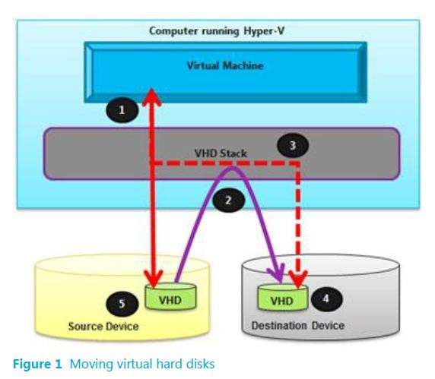
Virtual Hard Disks
When creating a virtual machine, having three options concerning the virtual hard disks associated with the new virtual machines:
Fixed-size
Dynamically expanding
Differencing

Slide 11
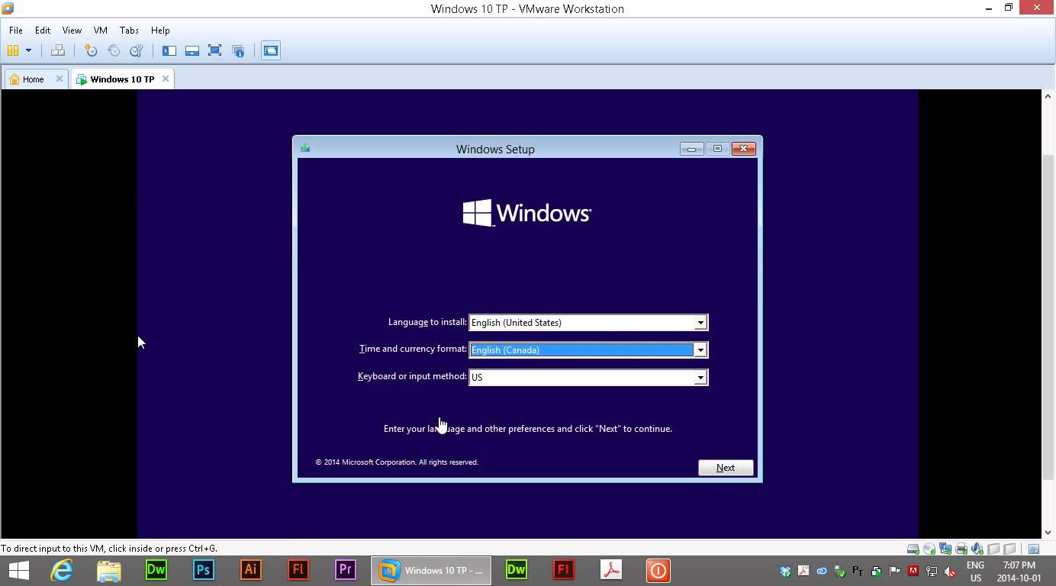
Guest Operating System Deployment
Guest operating systems can be installed in virtual machines the same way they are installed on physical systems. We can do the following:
Manually Installation
Lite Touch Installation (LTI)
Zero Touch Installation (ZTI)

Slide 12
Benefit of Hyper-V
To reduce Hardware cost
To reduce Software cost
To run multiple operating systems at the same time
To improve the efficiency of your computing resources.

Slide 13
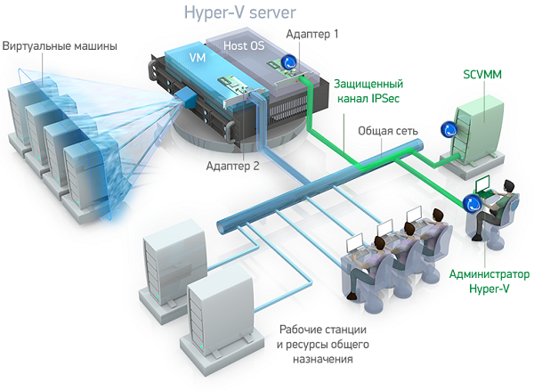
Thank you…

